Slide 1
Fake News / Deep Fakes
Czech Team / SSPS Prague
www.digitalyouth.eu

Slide 2
Fake News / Deep Fakes

Slide 3
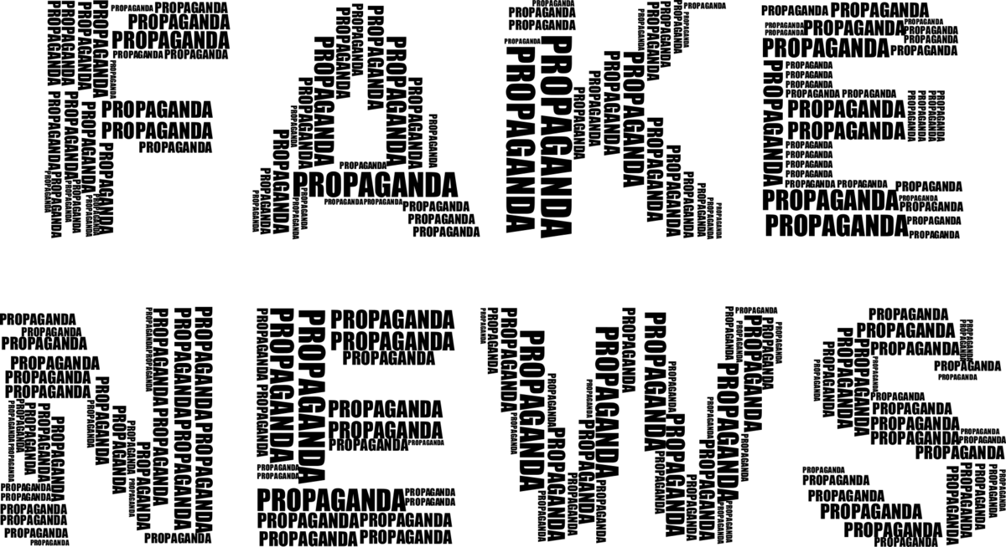
Definition of the topic / problem that is addressed
Fake news is a genre of intentionally spreading disinformation or hoaxes in order to influence and manipulate recipients. The fake news genre does not include parody or satire. Currently, the domain of fake news is misinformation websites, social networks, but it can be spread through all media platforms.

Slide 4
Short information on the topic / problem
Fake news in the narrower sense is a journalistic entity whose important feature is intentionality. As a forgery, a false message is created purposefully, knowingly, and thus differs from a misleading, erroneous or alarmist message (hoax). Erroneous, erroneous or inaccurate news therefore does not necessarily have to be fake news.

Slide 5
Short information on the topic / problem
Deep fake is a designation for realistic editing of the video - especially the faces of the depicted persons - which allows, for example, to very reliably change the facial expressions, i.e. the very speech of the individual actors of the video. In practice, we can put sentences into the mouths of people on the video that they have never uttered, swap characters, faces, etc. Deep fake uses advanced computer data processing with the use of artificial intelligence (it uses neural networks with the ability to learn) and the quality of the resulting product - an edited video - is constantly increasing.

Slide 6
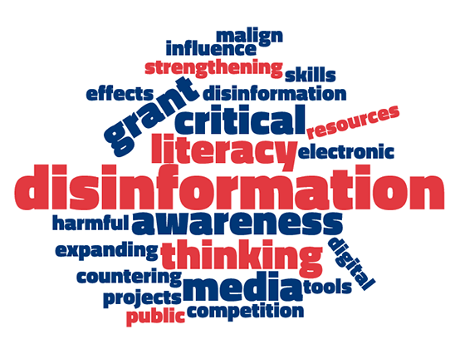
Why is it important this topic to be addressed as part of the education / training of the young people
Young people very often use various digital technologies to obtain information. However, they do not have enough experience as adults and are thus more prone to believe false information that can scare them, harm them...

Slide 7
What should teachers / trainers know about this topic to be able to teach / train young people on that matter
information verification
information verification
internet security
how to defend yourself on the internet

Slide 8
References
https://applieddigitalskills.withgoogle.com/s/en/home
Journalism, fake news & disinformation: handbook for journalism education and training (https://unesdoc.unesco.org/ark:/48223/pf0000265552)
https://us.norton.com/blog/emerging-threats/deep-web-vs-dark-web#

Slide 9
www.digitalyouth.eu
Creative Commons Attribution-NonCommercial 4.0 International License
Attribution-NonCommercial (CC BY-NC 4.0)
You will have to acknowledge the author (when mentioned) and to refer to YDML project.
You are free to:
Share — copy and redistribute the material in any medium or format for free use
Adapt — remix, transform, and build upon the material
The YDML project has been funded with support from the European Commission in the frames of Erasmus+ program, KA2 (ref. No 608788-EPP-1-2019-1-BG-EPPKA2-CBY-ACPALA). This publication reflects the views only of the author, and the Commission cannot be held responsible for any use which may be made of the information contained therein.

