Slide 1
DigComp 2.2
Name of the trainer
www.digitalyouth.eu

Slide 2
Some background

Slide 3
DigComp
Digital Competence Framework for Citizens (DigComp) provides a common understanding of what digital competence is:
“Digital Competence can be broadly defined as the confident, critical and creative use of ICT to achieve goals related to work, employability, learning, leisure, inclusion and/or participation in society. Digital competence is a transversal key competence which, as such, enables us to acquire other key competences (e.g. language, mathematics, learning to learn, cultural awareness). It is related to many of the 21st Century skills which should be acquired by all citizens, to ensure their active participation in society and the economy.”
DIGCOMP: A Framework for Developing and Understanding Digital Competence in Europe, Publications Office of the European Union, Luxembourg, 2013, ISBN 978-92-79-31465-0, doi:10.2788/52966, JRC83167.
Notes:
DigComp also provides a basis for framing digital skills policy.

Slide 4
DigComp
The DigComp project is carried out by the Joint Research Centre (JRC) on behalf of the European Commission since 2010;
In 2013, after a wide stakeholder consultation, JRC published the report “DIGCOMP: A Framework for Developing and Understanding Digital Competence in Europe”, which contains:
detailed descriptions of the competences necessary for a person to be proficient in digital environments;
describes them in terms of knowledge, skills, and attitudes;
suggests 3 proficiency levels for each competence;
provides a self-assessment grid for mapping digital competence levels;
relevance of Digital Competence for other Key Competences for Lifelong learning
Notes:
The 8 key competences for LLL: Literacy competence; Multilingual competence; Mathematical competence and competence in science, technology and engineering; Digital competence; Personal, social and learning to learn competence; Citizenship competence; Entrepreneurship competence; Cultural awareness and expression competence
The Official Journal 2018/C 189/01: https://eur-lex.europa.eu/legal-content/EN/TXT/?uri=CELEX%3A32018H0604%2801%29&qid=1669728075062

Slide 5
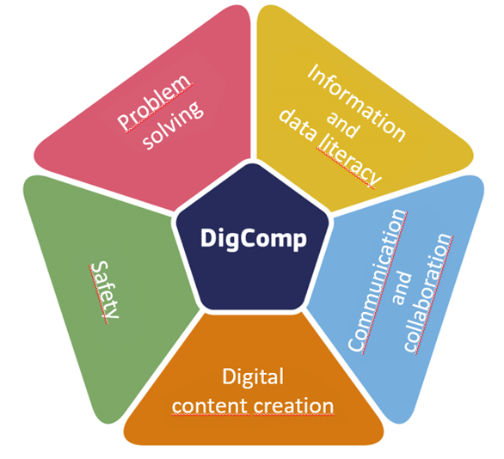
DigComp - areas of digital competence
The areas of digital competence are the following:
1. Information: identify, locate, retrieve, store, organise and analyse digital information, judging its relevance and purpose.
2. Communication: communicate in digital environments, share resources through online tools, link with others and collaborate through digital tools, interact with and participate in communities and networks, cross-cultural awareness.
3. Content-creation: Create and edit new content (from word processing to images and video); integrate and re-elaborate previous knowledge and content; produce creative expressions, media outputs and programming; deal with and apply intellectual property rights and licences.
4. Safety: personal protection, data protection, digital identity protection, security measures, safe and sustainable use.
5. Problem-solving: identify digital needs and resources, make informed decisions as to which are the most appropriate digital tools according to the purpose or need, solve conceptual problems through digital means, creatively use technologies, solve technical problems, update one's own and others' competences.
Notes:
The 8 key competences for LLL: Literacy competence; Multilingual competence; Mathematical competence and competence in science, technology and engineering; Digital competence; Personal, social and learning to learn competence; Citizenship competence; Entrepreneurship competence; Cultural awareness and expression competence
The Official Journal 2018/C 189/01: https://eur-lex.europa.eu/legal-content/EN/TXT/?uri=CELEX%3A32018H0604%2801%29&qid=1669728075062

Slide 6
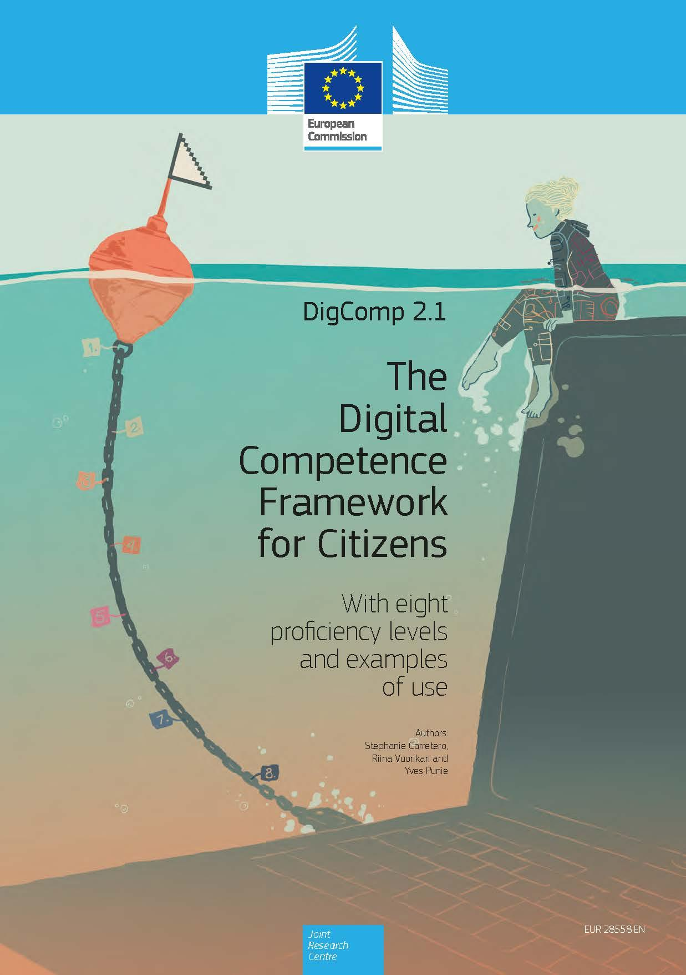
DigComp 2.1
DigComp 2.1 (2017) is a further development of the Digital Competence Framework for Citizens.
Based on the reference conceptual model published in DigComp 2.0, it presents 8 proficiency levels and examples of use applied to the learning and employment field.
Notes:
https://publications.jrc.ec.europa.eu/repository/handle/JRC106281
BG language: https://www.ipa.government.bg/en/ramka-za-digitalni-kompetentnosti

Slide 7
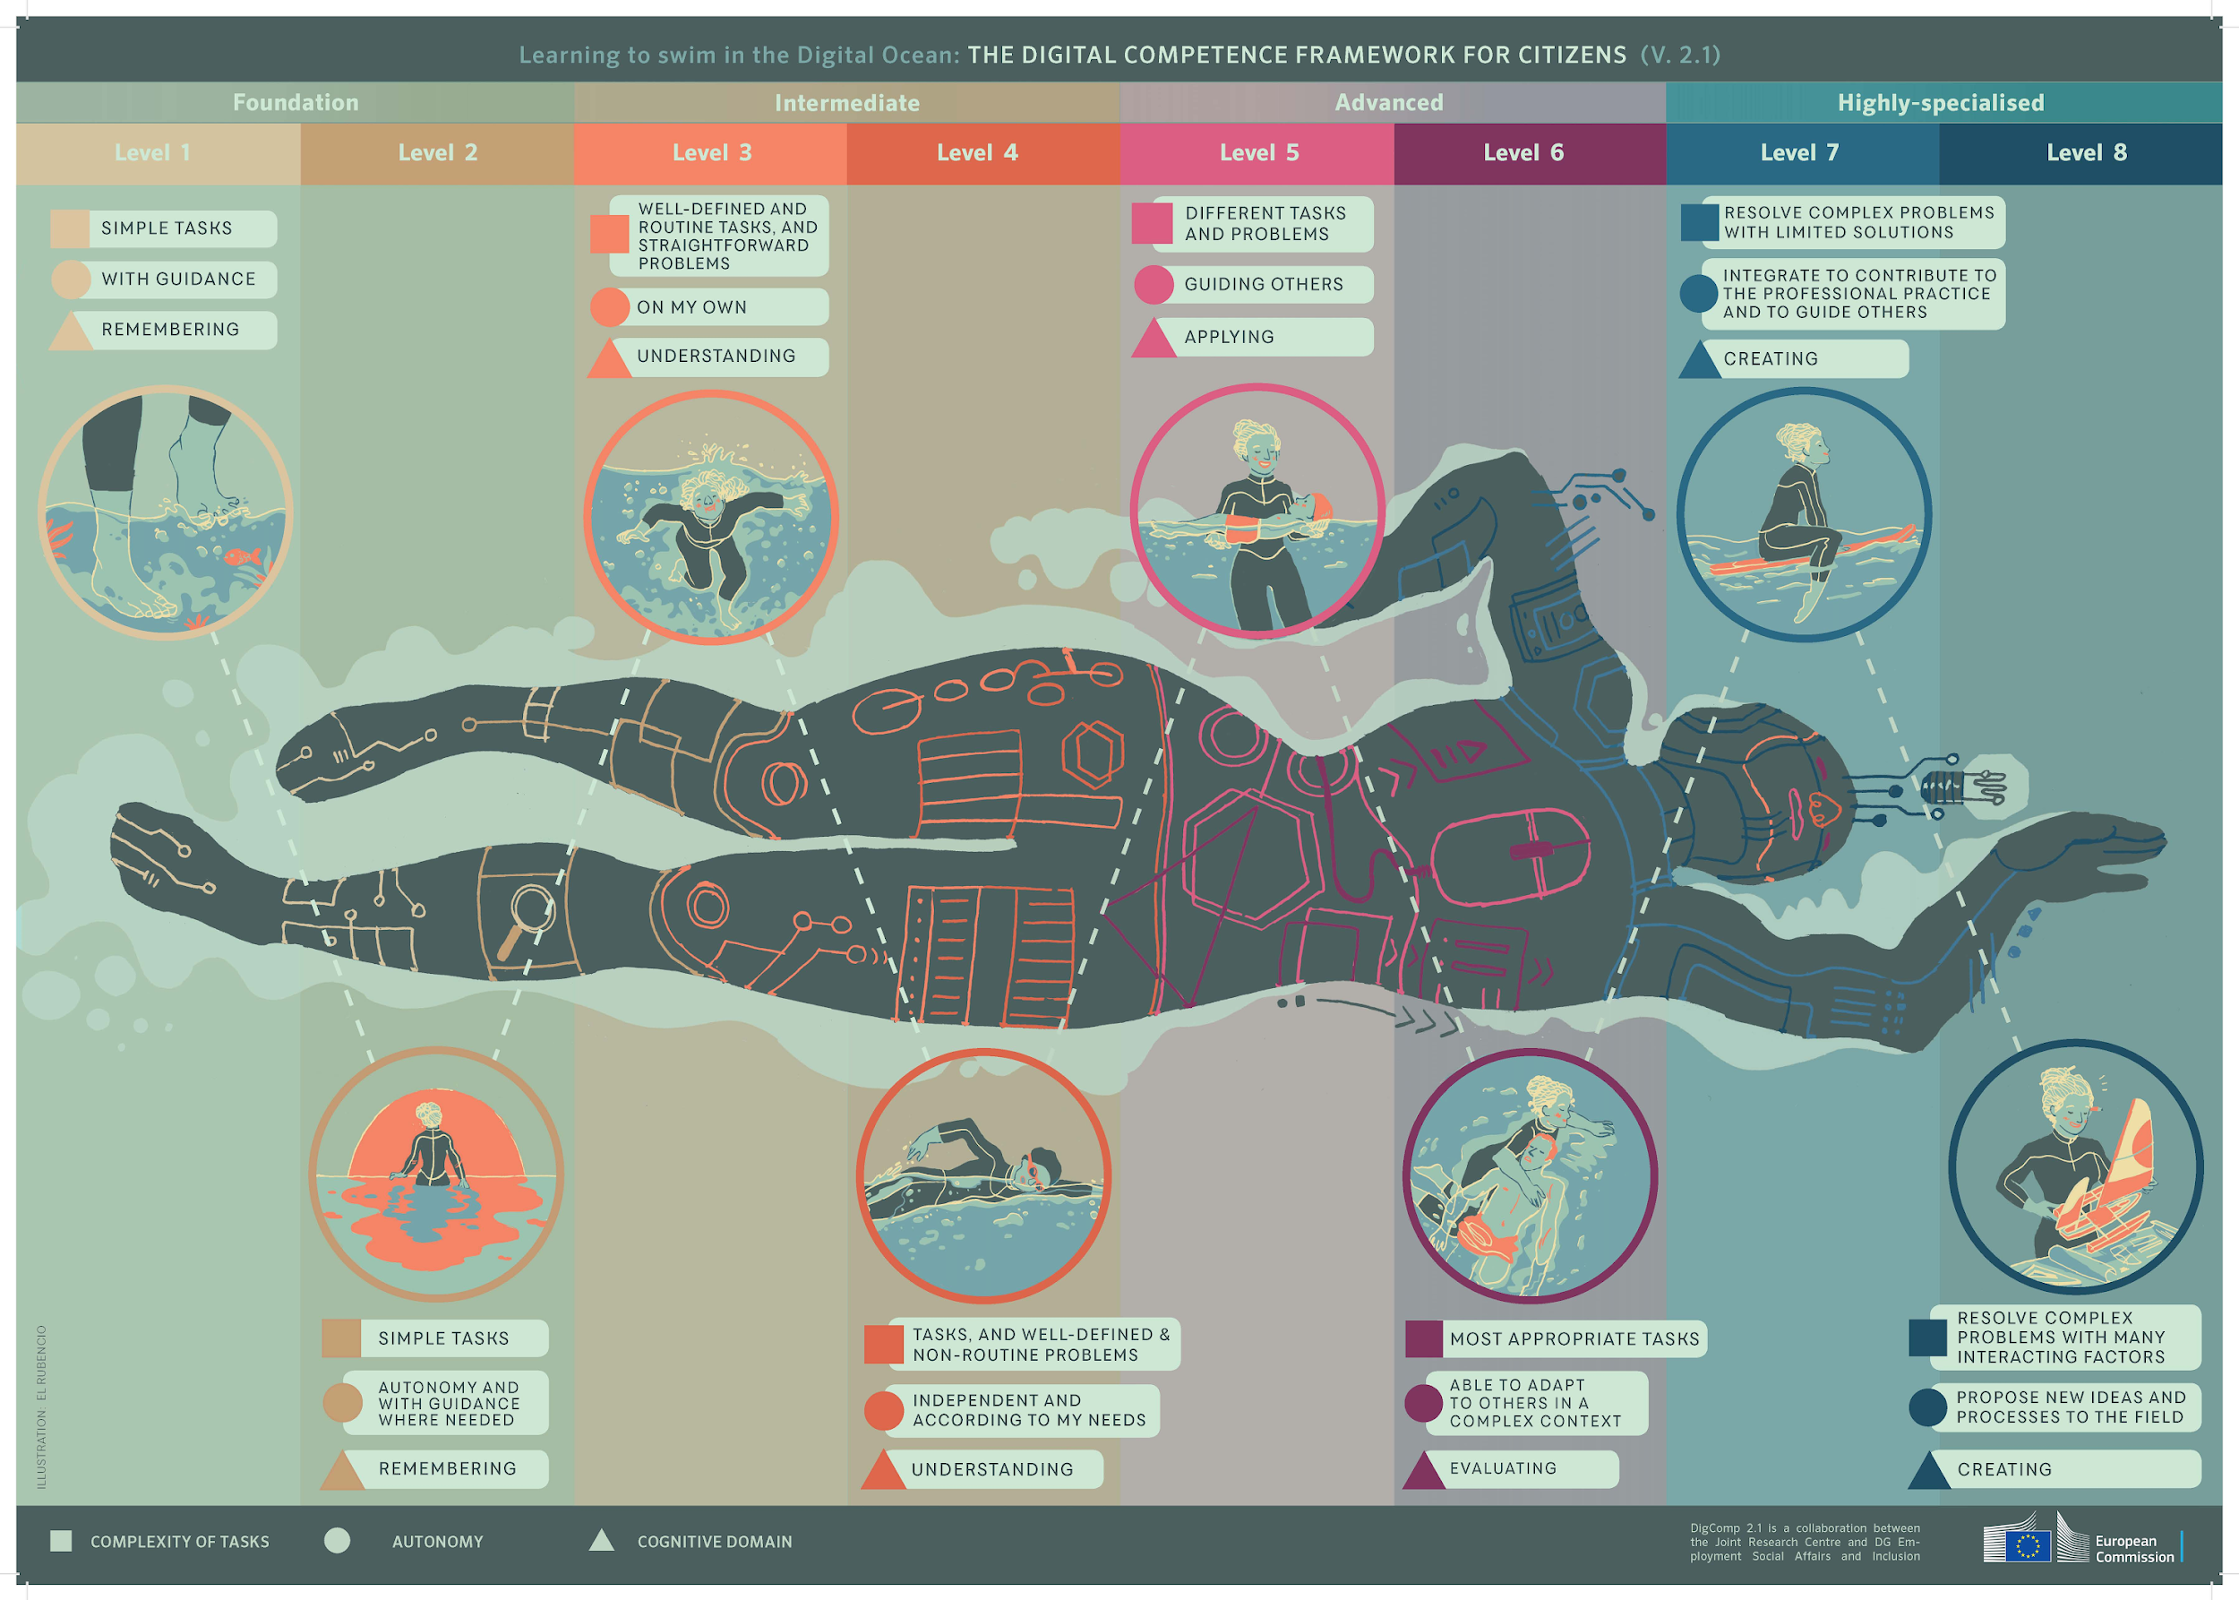
DigComp 2.1
learning to swim in the digital ocean – the 8 proficiency levels
Notes:
4 levels: Foundation; Intermediate; Advanced; Highly specialised – each level has 2 steps
The levels differ by: complexity of tasks (person can do); autonomy (with guidance, on his own… to guide others) & cognitive domain (remembering, understanding, applying, evaluating, creating)

Slide 8
DigComp 2.2 (2022)
DigComp 2.2 framework - more than 250 new examples of knowledge, skills and attitudes, incl. new and emerging ones such as systems driven by artificial intelligence (AI).
A specific appendix on Citizens interacting with AI systems and on Remote/Hybrid work.
The pentagon >>>>

Slide 9
Discussion: The areas of digital competence
Notes:
Initiate a discussion on the 5 areas of digital competence according to DigComp framework: What stays behind each area – what knowledge, skills and attitudes? How do the participants in the training understand each area of digital competence?
This discussion can be organized as a group work – divide participants in 5 groups and give each group 1 area of digital competence to elaborate on it. Depending on the level of competence of the participants, this phase of the activity might take 10 minutes or more. Ask groups to present their conclusions and give opportunity of the other participants to commend and add information.
After the discussion, quickly review through the areas’ content, presented on the next slide. At the end, give a chance to the participants to reflect on the outcomes of their group work and the DigComp 2.2.

Slide 10
1.1. Browsing, searching and filtering data, information and digital content
1.2. Evaluation data, information and digital content
1.3. Managing data, information and digital content
DigComp 2.2
The areas of digital competence
2.1. Interacting through digital technologies
2.2. Sharing information and content through digital technologies
2.3. Engaging in citizenship through digital technologies
2.4. Collaborating through digital technologies
2.5. netiquette
2.6. Managing digital identity
3.1. Developing digital content
3.2. Integrating and re-elaborating digital content
3.3. Copyright and licenses
3.4. Programming
4.1. Protecting devices
4.2. Protecting personal data and privacy
4.3. Protecting health and well-being
4.4. Protecting the environment
5.1. Solving technical problems
5.2. Identifying needs and technological responses
5.3. Creatively using digital technologies
5.4. Identifying digital competences gaps
Notes:
Another practical activity during a training might be to ask participants to discuss in groups the different levels of proficiency in each area and to list the competences in certain order. For instance: what would it mean to be at a starting (foundation) level of competence in safety and what would be more advanced levels of proficiency?
Reflection and discussion on these topics will allow participants to master understanding about the depth of the competences in each area and to consider for these can be developed and updated.

Slide 11
Digital Competence of Educators

Slide 12
DigCompEdu (2017)
Why is it necessary? The duty to help students to become digitally competent requires educators to develop their own digital competence
The DigCompEdu framework is directed towards educators at all levels of education, from early childhood to higher and adult education, including general and vocational education and training, special needs education, and non-formal learning contexts;
It aims to provide a general reference frame for developers of Digital Competence models, educational organisations, professional training providers, etc.
Notes:
Before introducing the DigCompEdu framework (on the next slide) the trainer could involve the audience in a discussion on: what additional competences (apart from those listed in DigComp) could / should teachers (trainers / educators) have in order to support learners in mastering digital competences.

Slide 13
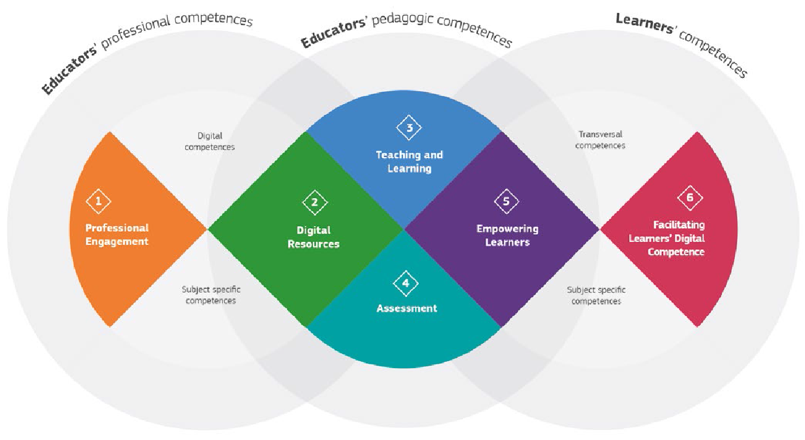
DigCompEdu areas and scopes
The DigCompEdu framework distinguishes six different areas
in which educators’ Digital Competence is expressed with a
total of 22 competences

Slide 14
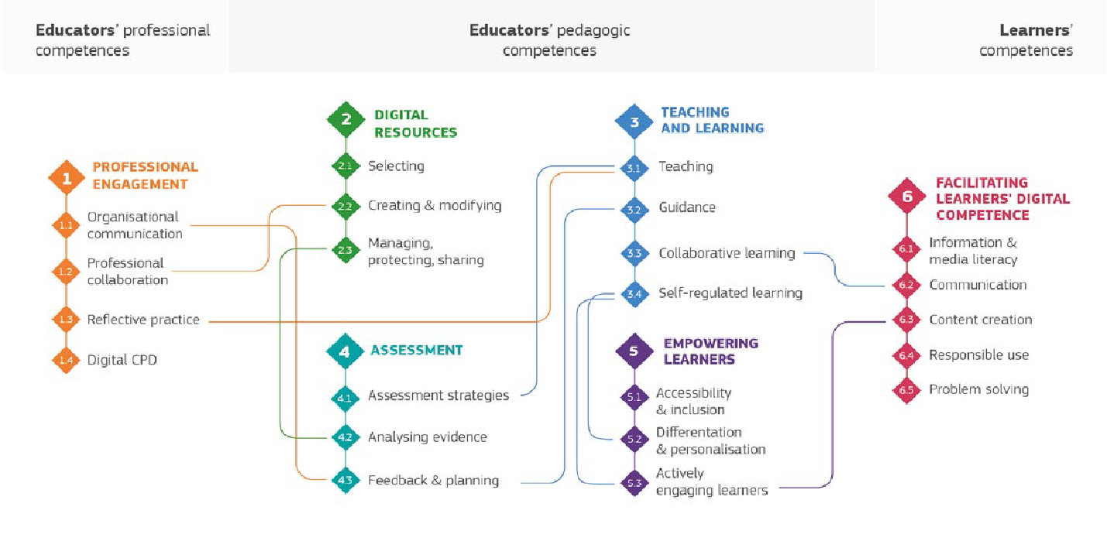
DigCompEdu competences and their connections

Slide 15
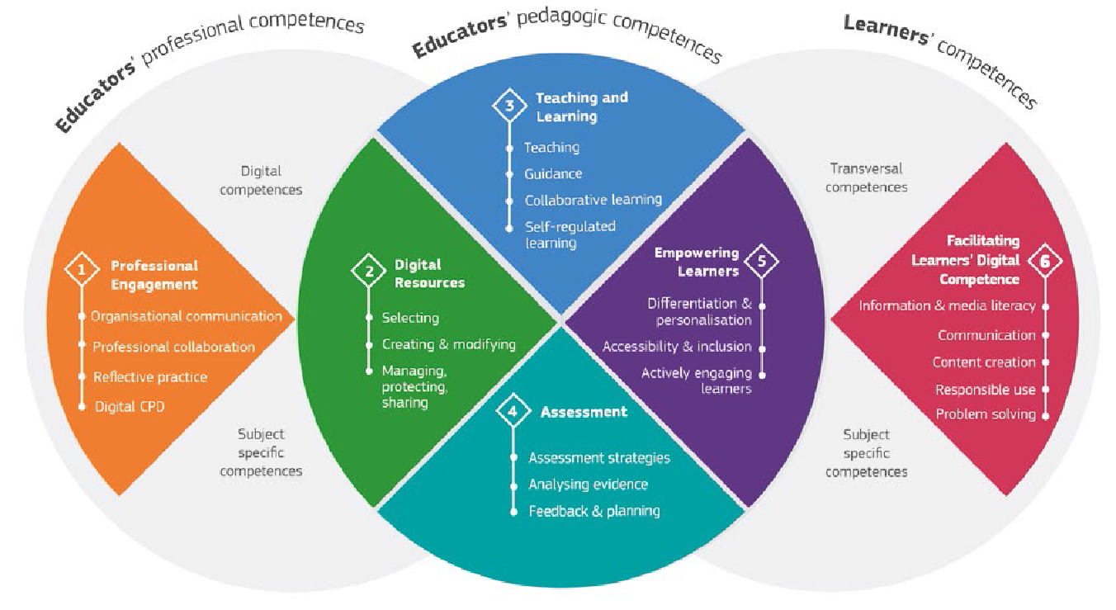
DigCompEdu framework – synthesis

Slide 16
01 Professional Engagement
Organisational
communication
To use digital technologies
to enhance organisational
communication with
learners, parents and
third parties. To contribute
to collaboratively
developing and
improving organisational
communication strategies.
Professional
collaboration
To use digital technologies
to engage in collaboration
with other educators,
sharing and exchanging
knowledge and experience,
and collaboratively
innovating pedagogic
practices.
Reflective
practice
To individually and
collectively reflect on,
critically assess and
actively develop one’s
own digital pedagogical
practice and that of one’s
educational community.
Digital Continuous
Professional
Development (CPD)
To use digital sources and
resources for continuous
professional development.

Slide 17
02 Digital Resources
Selecting
digital resources
To identify, assess and select digital
resources for teaching and learning.
To consider the specific learning
objective, context, pedagogical
approach, and learner group, when
selecting digital resources and
planning their use.
Creating and modifying
digital resources
To modify and build on existing
openly-licensed resources and other
resources where this is permitted.
To create or co-create new digital
educational resources. To consider
the specific learning objective,
context, pedagogical approach, and
learner group, when designing digital
resources and planning their use.
Managing, protecting and
sharing digital resources
To organise digital content and make
it available to learners, parents
and other educators. To effectively
protect sensitive digital content. To
respect and correctly apply privacy
and copyright rules. To understand
the use and creation of open licenses
and open educational resources,
including their proper attribution.

Slide 18
03 teaching and Learning
Teaching
To plan for and implement
digital devices and resources in the teaching
process, so as to enhance
the effectiveness of teaching interventions. To
appropriately manage and
orchestrate digital teaching
strategies. To experiment
with and develop new
formats and pedagogical
methods for instruction.
Guidance
To use digital technologies
and services to enhance the interaction with learners, individually and collectively, within and outside the learning session. To use digital technologies to offer timely and targeted guidance and assistance.
To experiment with and
develop new forms and
formats for offering
guidance and support.
Collaborative learning
To use digital technologies
to foster and enhance
learner collaboration.
To enable learners to
use digital technologies
as part of collaborative
assignments, as a
means of enhancing
communication,
collaboration and
collaborative knowledge
creation.
Self-regulated learning
To use digital technologies
to support learners’ self-regulated learning, i.e. to
enable learners to plan,
monitor and reflect on
their own learning, provide
evidence of progress,
share insights and come
up with creative solutions.

Slide 19
04 Assessment
Assessment strategies
To use digital technologies for formative and summative assessment. To enhance the diversity and suitability of assessment formats and approaches.
Analysing evidence
To generate, select, critically analyse and interpret digital
evidence on learner activity, performance and progress, in order to inform teaching and learning.
Feedback and planning
To use digital technologies to provide targeted and timely feedback to learners. To adapt teaching strategies and to provide targeted support, based on the evidence generated by the digital technologies used. To enable learners and parents to understand the evidence provided by digital technologies and use it for decision-making.

Slide 20
05 Empowering Learners
Actively engaging learners
To use digital technologies to
foster learners’ active and creative
engagement with a subject matter.
To use digital technologies within
pedagogic strategies that foster
learners’ transversal skills, deep
thinking and creative expression. To open up learning to new, real-world contexts, which involve learners themselves in hands-on activities, scientific investigation or complex problem solving, or in other ways increase learners’ active involvement in complex subject matters.
Accessibility and inclusion
To ensure accessibility to learning resources and activities, for all learners, including those with special needs. To consider and respond to learners’ (digital) expectations, abilities, uses and misconceptions, as well as contextual, physical or cognitive constraints to their use of digital technologies.
Differentiation and personalisation
To use digital technologies to
address learners’ diverse learning needs, by allowing learners to advance at different levels and
speeds, and to follow individual learning pathways and objectives.

Slide 21
06 Facilitating Learners’ Digital Competence
Digital content creation
To incorporate learning activities, assignments and assessments which require learners to express themselves through digital means, and to modify and create digital content in different formats. To teach learners how copyright and licenses apply to digital content, how to reference sources and attribute licenses.
Responsible use
To take measures to ensure learners’ physical, psychological and social wellbeing while using digital technologies. To empower learners to manage risks and use digital technologies safely and responsibly.
Digital problem solving
To incorporate learning activities, assignments and assessments which require learners to identify and solve technical problems, or to transfer technological knowledge creatively to new situations
Information and media literacy
To incorporate learning activities, assignments and assessments which require learners to articulate information needs; to find information and resources in digital environments; to organise, process, analyse and interpret information; and to compare and critically evaluate the credibility and reliability of information and its sources.
Digital communication and collaboration
To incorporate learning activities, assignments and assessments which require learners to effectively and responsibly use digital technologies for communication, collaboration and civic participation.

Slide 22
References
Punie, Y. and Brecko, B., editor(s), Ferrari, A., DIGCOMP: A Framework for Developing and Understanding Digital Competence in Europe, Publications Office of the European Union, Luxembourg, 2013, ISBN 978-92-79-31465-0, doi:10.2788/52966, JRC83167; https://publications.jrc.ec.europa.eu/repository/handle/JRC83167
Council Recommendation of 22 May 2018 on key competences for lifelong learning, ST/9009/2018/INIT; The Official Journal 2018/C 189/01: https://eur-lex.europa.eu/legal-content/EN/TXT/?uri=OJ%3AC%3A2018 %3A189 %3ATOC
Carretero Gomez, S., Vuorikari, R. and Punie, Y., DigComp 2.1: The Digital Competence Framework for Citizens with eight proficiency levels and examples of use, Publications Office of the European Union, Luxembourg, 2017, ISBN 978-92-79-68006-9 (pdf), JRC106281.
Learning to swim in the Digital Ocean (poster): https://joint-research-centre.ec.europa.eu/system/files/2017-05/digcomp-framework-poster-af-ok.pdf

Slide 23
References
Vuorikari, R., Kluzer, S. and Punie, Y., DigComp 2.2: The Digital Competence Framework for Citizens - With new examples of knowledge, skills and attitudes, Publications Office of the European Union, Luxembourg, 2022, ISBN 978-92-76-48882-8 (online), JRC128415: https://publications.jrc.ec.europa.eu/repository/handle/JRC128415
Punie, Y., editor(s), Redecker, C., European Framework for the Digital Competence of Educators: DigCompEdu, Publications Office of the European Union, Luxembourg, 2017, ISBN 978-92-79-73494-6 (pdf), JRC107466: https://publications.jrc.ec.europa.eu/repository/handle/JRC107466

Slide 24
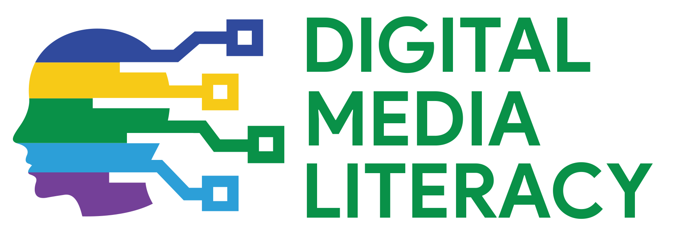
Do you have questions?
www.digitalyouth.eu
Creative Commons Attribution-NonCommercial 4.0 International License
Attribution-NonCommercial (CC BY-NC 4.0)
You will have to acknowledge the author (when mentioned) and to refer to YDML project.
You are free to:
Share — copy and redistribute the material in any medium or format for free use
Adapt — remix, transform, and build upon the material
The YDML project has been funded with support from the European Commission in the frames of Erasmus+ program, KA2 (ref. No 608788-EPP-1-2019-1-BG-EPPKA2-CBY-ACPALA). This publication reflects the views only of the author, and the Commission cannot be held responsible for any use which may be made of the information contained therein.

