Slide 1
Ulwazi lwemidiya e dijithali
Obhalile:
www.digitalyouth.eu

Slide 2
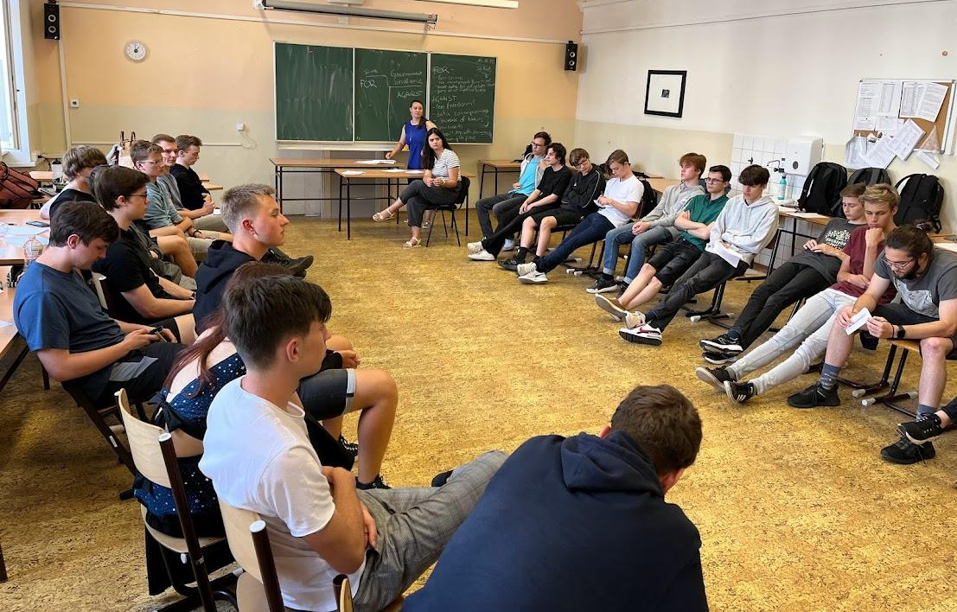
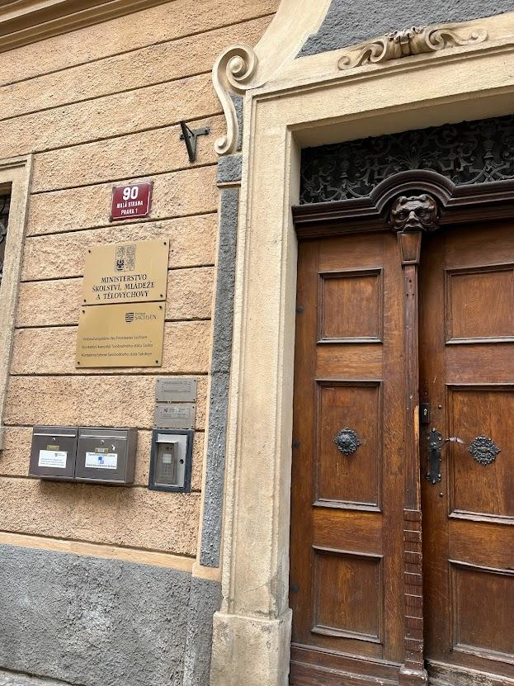
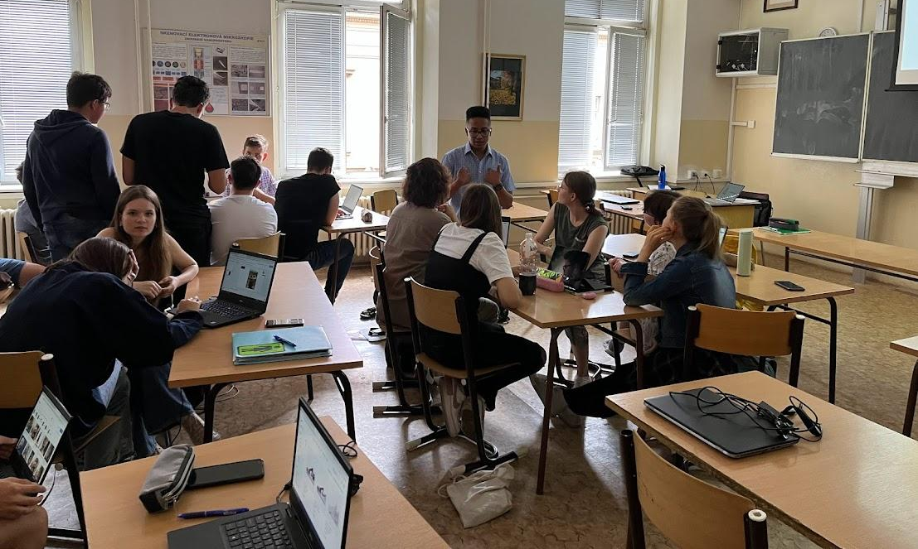
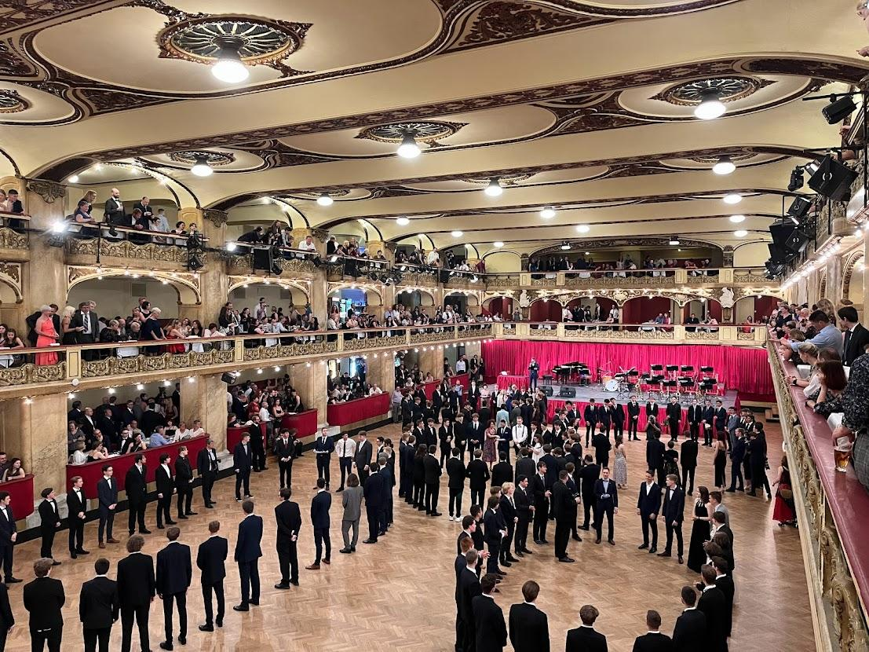
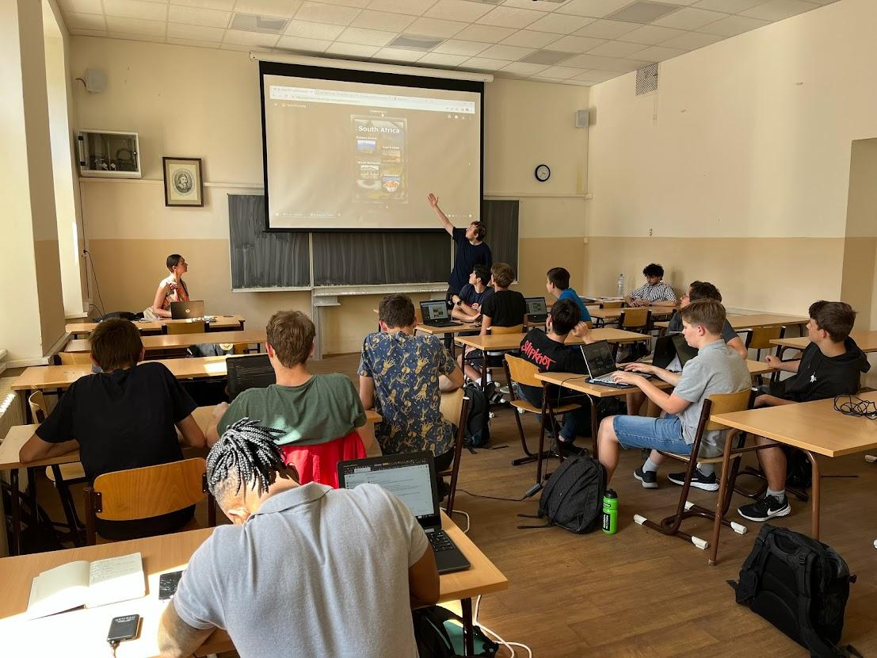
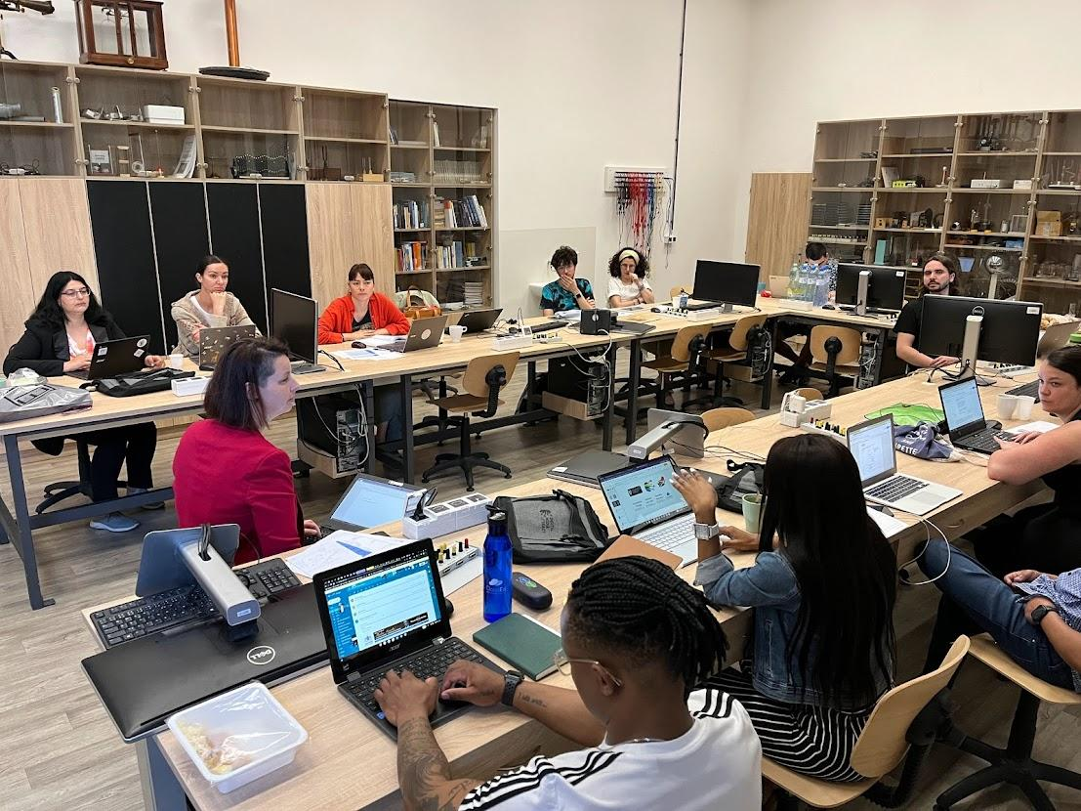

Slide 3
Ama-Ice Breakers

Slide 4
I Digital Media Literacy- ingxoxo

Slide 5
ULWAZI LWE-DIJITHALI
Ulwazi lwe midiya e-dijithali
ULWAZI LWE-MIDIYA

Slide 6
Ulwazi noma Ikhono?
Ulwazi lwe midiya e-dijithali
ULWAZI LWE-DIJITHALI
ULWAZI LWE-MIDIYA
*Ikhono = ulwazu, amakhono, isimo sengqondo

Slide 7
ULWAZI LWE-DIJITHALI
Ulwazi lwe midiya e-dijithali
ULWAZI LWE-MIDIYA

Slide 8
Ulwazi lwe-Midiya

Slide 9
Iyini i-Media Literacy ngokusho kwakho? Wabelana ngombono wakho.
Ayikho incazelo elungile noma engalungile.
Yabelana ngombono wakho nabanye ababambiqhaza ku-workshop.
Ngale ndlela sizodala incazelo eyiqoqo ye-Media Literacy yeqembu lethu elithile.
Notes:
https://medialiteracynow.org/what-is-media-literacy/
Set of skills that helps people to analyze the messages that they receive and send; to unlock the meaning…
5 key questions: 1/ Who created that message; 2/ What creative techniques are used to attract my attention?; 3/ How might different people understand this message differently from me?; 4/ What lifestyles, values and points of view are represented in or omitted from this message?; 5/ Why is this message being sent?
Media literacy expands the concept of literacy, as today’s messages come in many forms and literacy can no longer refer simply to the ability to read and write. Media Literacy is the ability to:
Decode media messages (including the systems in which they exist).
Assess the influence of those messages on thoughts, feelings, and behaviors.
Create media thoughtfully and conscientiously.
Key 21st century skill which teaches students to apply critical thinking to media messages and to use media to create their own messages; critical to the health and well-being (offers a solution to public health issues, such as body image issues and substance use, exacerbated by toxic media messages); Empowers all people to engage in a global media environment… (civic engagement; better digital citizens as we consume media, produce and share own stories);
Used well, the media can entertain and inform children in positive ways. However, since most children aren’t taught to use media thoughtfully, many media messages contribute to public health issues such as obesity, bullying and aggression, low self-esteem, depression, negative body image, risky sexual behavior, and substance abuse, among other problems.
=============
https://www.verywellmind.com/what-is-media-literacy-5214468
Media literacy is the ability to apply critical thinking skills to the messages, signs, and symbols transmitted through mass media.
According to the Center for Media Literacy, media literacy "provides a framework to access, analyze, evaluate, create, and participate with messages in a variety of forms—from print to video to the internet. Media literacy builds an understanding of the role of media in society as well as essential skills of inquiry and self-expression necessary for citizens of a democracy."
Media literacy enables us to understand and evaluate all of the media messages we encounter on a daily basis, empowering us to make better choices about what we choose to read, watch, and listen to. It also helps us become smarter, more discerning members of society. Media scholar W. James Potter observes that all media messages include four dimensions:¹⁰
Cognitive: the information that is being conveyed
Emotional: the underlying feelings that are being expressed
Aesthetic: the overall precision and artistry of the message
Moral: the values being conveyed through the message
Media psychologist Karen Dill-Shackleford suggests that we can use these four dimensions as a jumping off point to improve our media literacy skills.

Slide 10
Ulwazi lwemidiya-izincazelo ezahlukahlukene
1/ I-media literacy yikhono lokusebenzisa amakhono okucabanga okujulile emilayezweni, izimpawu kanye nezimpawu ezethulwa yimithombo yezindaba.
2/ I-Media literacy yikhono loku:
Susa ikhodi yemiyalezo yemidiya (okuhlanganisa nezinhlelo etholakala kuzo);
Hlola umthelela waleyo miyalezo emicabangweni, emizweni nasekuziphatheni;
Dala imidiya ngokucabangisisa nangokucophelela.
3/ Ngokuvumelana ne-Centre for Media Literacy, i-media literacy "ihlinzeka ngohlaka lokufinyelela, ukuhlaziya, ukuhlola, ukwakha, kanye nokuxhumana nemiyalezo ngezindlela ezihlukahlukene-kusukela kokunyatheliswayo kuye kuvidiyo kuye ku-inthanethi. indima yabezindaba emphakathini kanye namakhono abalulekile okuphenya kanye nokuziveza adingekayo ezakhamuzini zentando yeningi."
Isazi semidiya u-W. James Potter siphawula ukuthi yonke imilayezo yemidiya ihlanganisa izinhlangothi ezine:
Ingqondo: ulwazi oludluliswayo
Ngokomzwelo: imizwa engaphansi evezwayo
Ubuhle: ubuciko bomlayezo
Ukuziphatha: amanani adluliswa umlayezo
Notes:
https://medialiteracynow.org/what-is-media-literacy/
Set of skills that helps people to analyze the messages that they receive and send; to unlock the meaning…
5 key questions: 1/ Who created that message; 2/ What creative techniques are used to attract my attention?; 3/ How might different people understand this message differently from me?; 4/ What lifestyles, values and points of view are represented in or omitted from this message?; 5/ Why is this message being sent?
Media literacy expands the concept of literacy, as today’s messages come in many forms and literacy can no longer refer simply to the ability to read and write. Media Literacy is the ability to:
Decode media messages (including the systems in which they exist) [>>>> напр. мемета?]
Assess the influence of those messages on thoughts, feelings, and behaviors.
Create media thoughtfully and conscientiously.
Key 21st century skill which teaches students to apply critical thinking to media messages and to use media to create their own messages; critical to the health and well-being (offers a solution to public health issues, such as body image issues and substance use, exacerbated by toxic media messages); Empowers all people to engage in a global media environment… (civic engagement; better digital citizens as we consume media, produce and share own stories);
Used well, the media can entertain and inform children in positive ways. However, since most children aren’t taught to use media thoughtfully, many media messages contribute to public health issues such as obesity, bullying and aggression, low self-esteem, depression, negative body image, risky sexual behavior, and substance abuse, among other problems.
=============
https://www.verywellmind.com/what-is-media-literacy-5214468
Media literacy is the ability to apply critical thinking skills to the messages, signs, and symbols transmitted through mass media.
According to the Center for Media Literacy, media literacy "provides a framework to access, analyze, evaluate, create, and participate with messages in a variety of forms—from print to video to the internet. Media literacy builds an understanding of the role of media in society as well as essential skills of inquiry and self-expression necessary for citizens of a democracy."
Media literacy enables us to understand and evaluate all of the media messages we encounter on a daily basis, empowering us to make better choices about what we choose to read, watch, and listen to. It also helps us become smarter, more discerning members of society. Media scholar W. James Potter observes that all media messages include four dimensions:¹⁰
Cognitive: the information that is being conveyed
Emotional: the underlying feelings that are being expressed
Aesthetic: the overall precision and artistry of the message
Moral: the values being conveyed through the message
Media psychologist Karen Dill-Shackleford suggests that we can use these four dimensions as a jumping off point to improve our media literacy skills.

Slide 11
Ulwazi lwe dijithali

Slide 12
Iyini i-Digital Literacy ngokusho kwakho? wanelana ngombono wakho
Ayikho incazelo elungile noma engalungile.
Yabelana ngombono wakho nabanye ababambiqhaza ku-workshop.
Ngale ndlela sizodala incazelo eyiqoqo ye-Digital Literacy yeqembu lethu elithile.
Notes:
Sleutelbevoegdhede vir LLL (2018): Digitale bevoegdheid behels die selfversekerde, kritiese en verantwoordelike gebruik van, en betrokkenheid by, digitale tegnologieë vir leer, by die werk en vir deelname aan die samelewing. Dit sluit inligting- en datageletterdheid, kommunikasie en samewerking, mediageletterdheid, digitale inhoudskepping (insluitend programmering), veiligheid (insluitend digitale welstand en bevoegdhede met betrekking tot kuberveiligheid), intellektuele eiendomsverwante vrae, probleemoplossing en kritiese denke in.

Slide 13
Ulwazi Lwe-Dijithali
NgokweSincomo Samakhono Abalulekile Wokufunda Impilo Yonke (2018):
Ikhono ledijithali libandakanya ukusetshenziswa ngokuzethemba, okubucayi nokunomthwalo wemfanelo, nokusebenzisana nobuchwepheshe bedijithali bokufunda, emsebenzini nokubamba iqhaza emphakathini. Lokhu kuhlanganisa ulwazi nolwazi lokufunda ngedatha, ukuxhumana nokusebenzisana, ukufunda nokubhala kwabezindaba, ukwakhiwa kokuqukethwe kwedijithali (okuhlanganisa nezinhlelo), ukuphepha (okuhlanganisa ukuphila kahle kwedijithali nekhono lokuvikeleka ku-inthanethi), imibuzo ehlobene nempahla yengqondo, ukuxazulula izinkinga nokucabanga okujulile.
Ulwazi... umsebenzi oyisisekelo nokusetshenziswa kwemishini ehlukene, isofthiwe namanethiwekhi; indlela ebucayi yokuba semthethweni, ukwethembeka kanye nomthelela wolwazi nedatha…
Amakhono... ikhono lokusebenzisa, ukufinyelela, ukuhlunga, ukuhlola, ukudala, ukuhlela nokwabelana ngokuqukethwe kwedijithali; ukuphatha nokuvikela ulwazi, okuqukethwe, idatha kanye nobunikazi bedijithali; ukubona nokusebenzisana ngempumelelo nesoftware, amadivaysi, ubuhlakani bokwenziwa noma amarobhothi
Izimo zengqondo… ezibucayi, nokho ilukuluku, nomqondo ovulekile… indlela yokuziphatha, ephephile nenesibopho sokusebenzisa
Notes:
Sleutelbevoegdhede vir LLL (2018): Digitale bevoegdheid behels die selfversekerde, kritiese en verantwoordelike gebruik van, en betrokkenheid by, digitale tegnologieë vir leer, by die werk en vir deelname aan die samelewing. Dit sluit inligting- en datageletterdheid, kommunikasie en samewerking, mediageletterdheid, digitale inhoudskepping (insluitend programmering), veiligheid (insluitend digitale welstand en bevoegdhede met betrekking tot kuberveiligheid), intellektuele eiendomsverwante vrae, probleemoplossing en kritiese denke in.
Die Amptelike Tydskrif 2018/C 189/01: https://eur-lex.europa.eu/legal-content/EN/TXT/?uri=OJ%3AC%3A2018 %3A189 %3ATOC

Slide 14
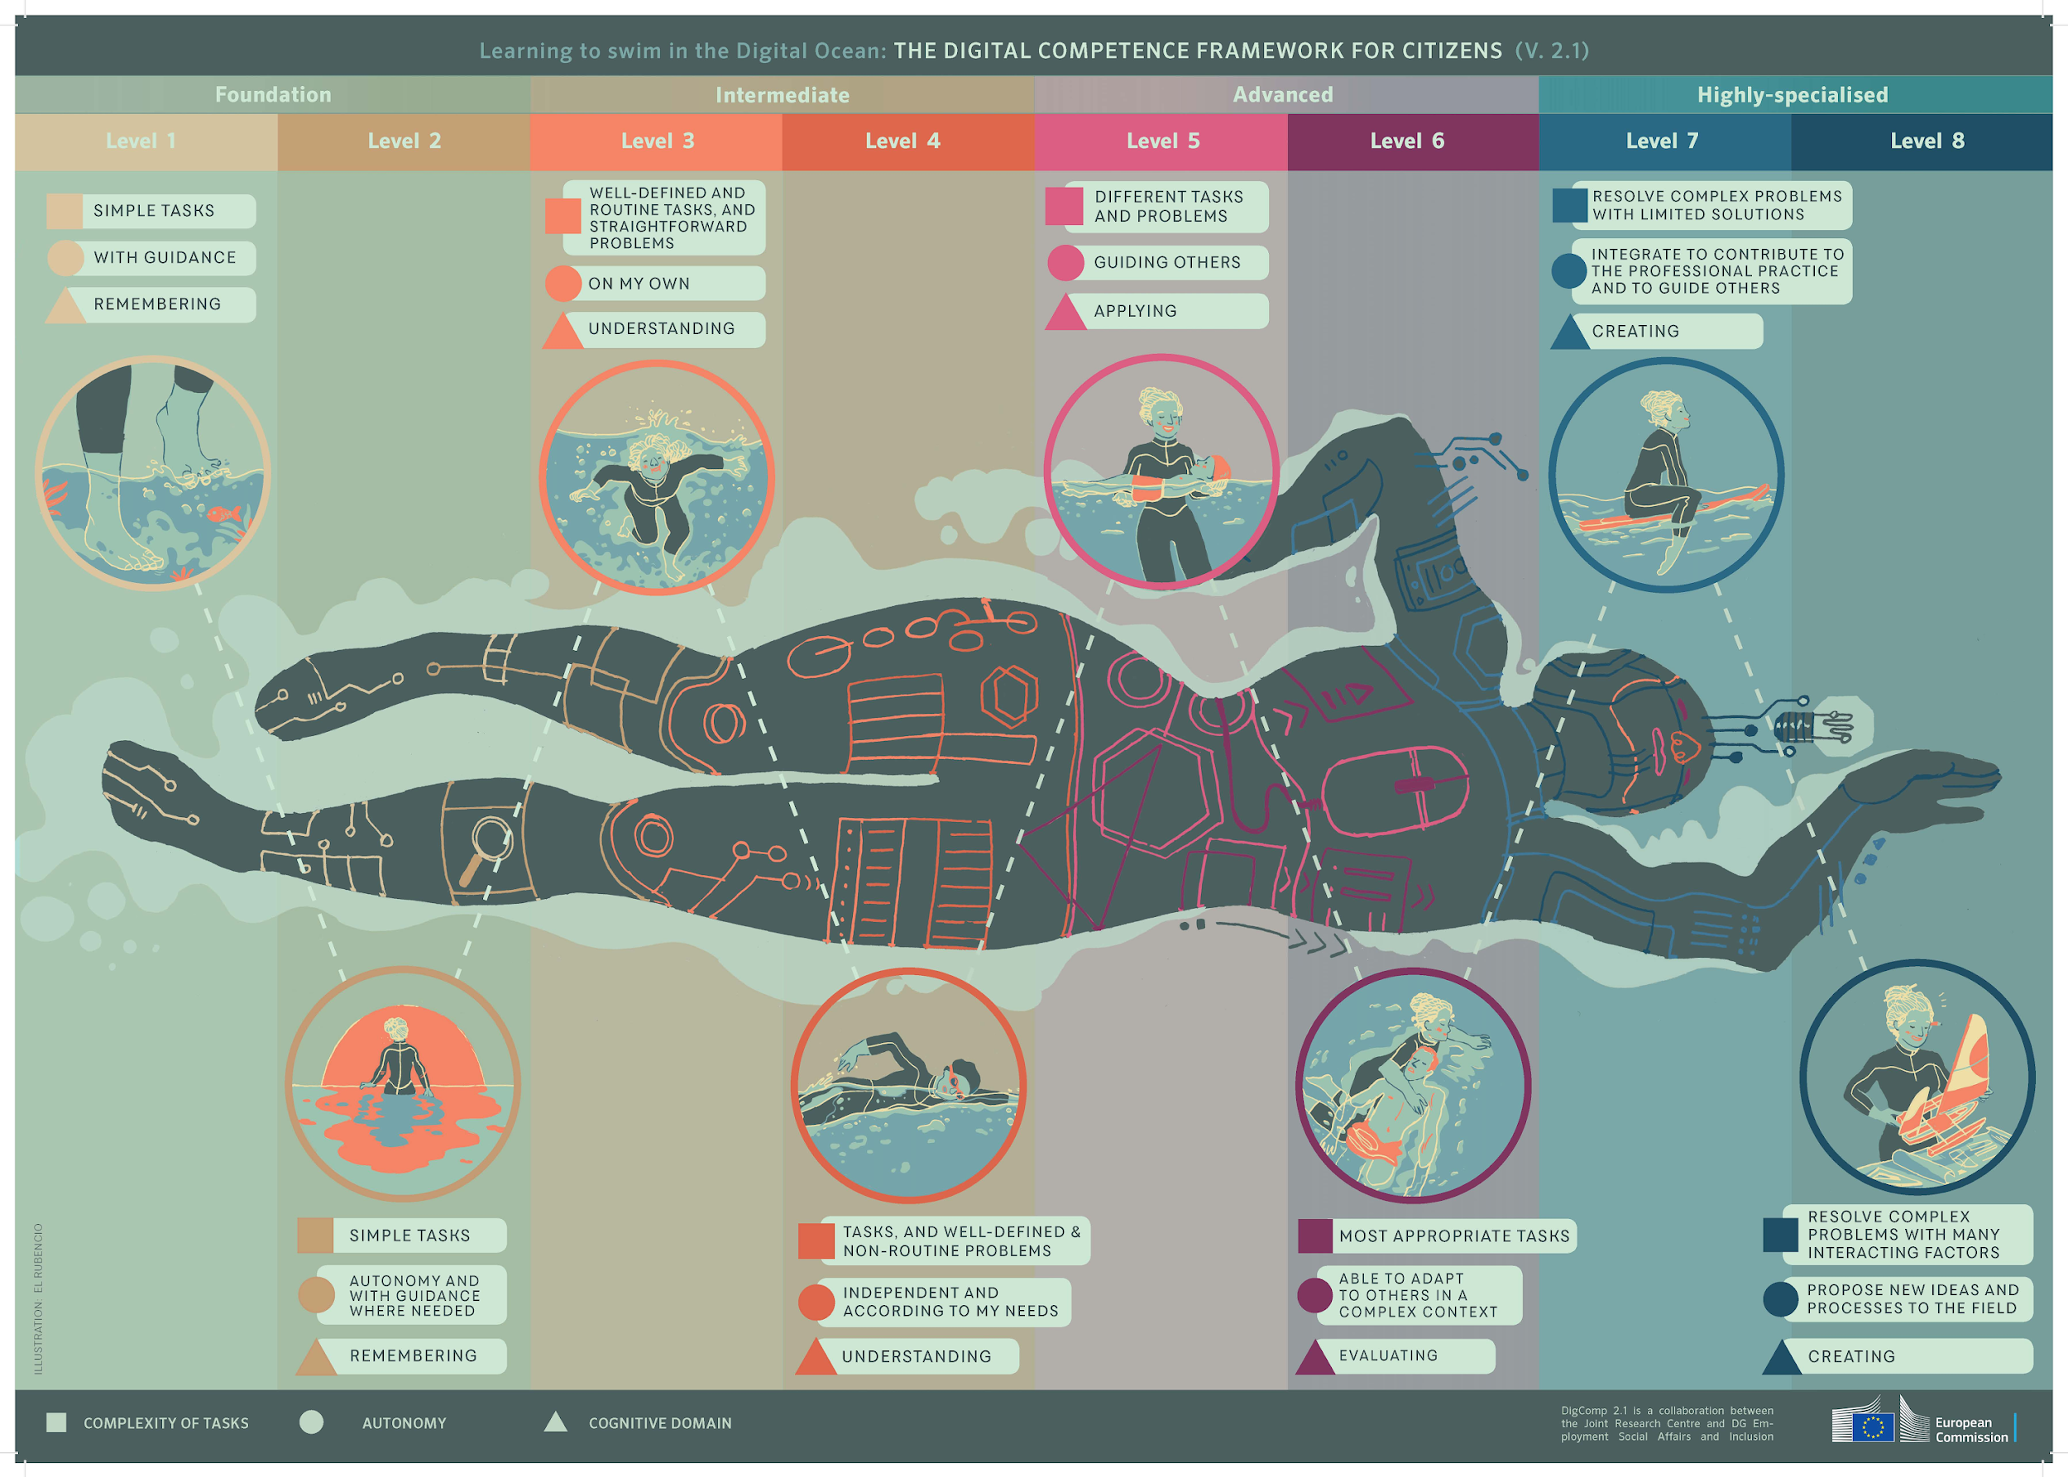
DigCom
Funda ukubhukuda olwandle lwedijithali
Notes:
4 vlakke: Grondslag; Intermediêr; Gevorderd; Hoogs gespesialiseerd - elke vlak het 2 stappe
Die vlakke verskil volgens: kompleksiteit van take (persoon kan doen); outonomie (met leiding, op sy eie ... om ander te lei) & kognitiewe domein (onthou, verstaan, toepas, evalueer, skep)

Slide 15
Ukufunda kwabezndaba kanye namakhono abalulekile
Amakhono Okufunda nokubhala:
Ulwazi: ikhono lokubona, ukuqonda, ukuveza, ukwakha nokuhumusha imiqondo, imizwa, amaqiniso nemibono ngazo zombili izindlela zomlomo nezibhaliwe, kusetshenziswa izinto ezibonwayo, ezizwakalayo/ ezilalelwayo nezidijithali kuzo zonke izigaba nezimo.
Amakhono: ukuxhumana ngomlomo nokubhaliwe + ukucinga, ukuqoqa nokucubungula ulwazi, ukusebenzisa amathuluzi
Imfundo yabezindaba nayo ibhekwa njengengxenye Yekhono Elibalulekile Lokuba yisakhamuzi - ngaphansi kwamakhono okuba yisakhamuzi (ikhono lokufinyelela, ukuqonda okujulile, nokusebenzelana nezinhlobo zemidiya zendabuko nezintsha kanye neqhaza nemisebenzi yabezindaba okufanele iqondwe ngentando yeningi. imiphakathi).
Notes:
Die 8 sleutelbevoegdhede vir LLL: Geletterdheidsbevoegdheid; Veeltalige bevoegdheid; Wiskundige bevoegdheid en bevoegdheid in wetenskap, tegnologie en ingenieurswese; Digitale bevoegdheid; Persoonlike, sosiale en leer-om-bevoegdheid; Burgerskapbevoegdheid; Entrepreneurskap bevoegdheid; Kulturele bewustheid en uitdrukkingsbevoegdheid
Die Amptelike Tydskrif 2018/C 189/01: https://eur-lex.europa.eu/legal-content/EN/TXT/?uri=OJ%3AC%3A2018 %3A189 %3ATOC

Slide 16
Ake sifinqe
I-Media Literacy ne Digital Literacy:
Kuhlobana kanjani okubili?
Siyini isizinda esiyinhloko futhi yini isizinda esingaphansi kwesinye?
Ingabe kulungile ukubuza ukuthi iyiphi eyinhloko, futhi yimuphi - ongaphansi?

Slide 17
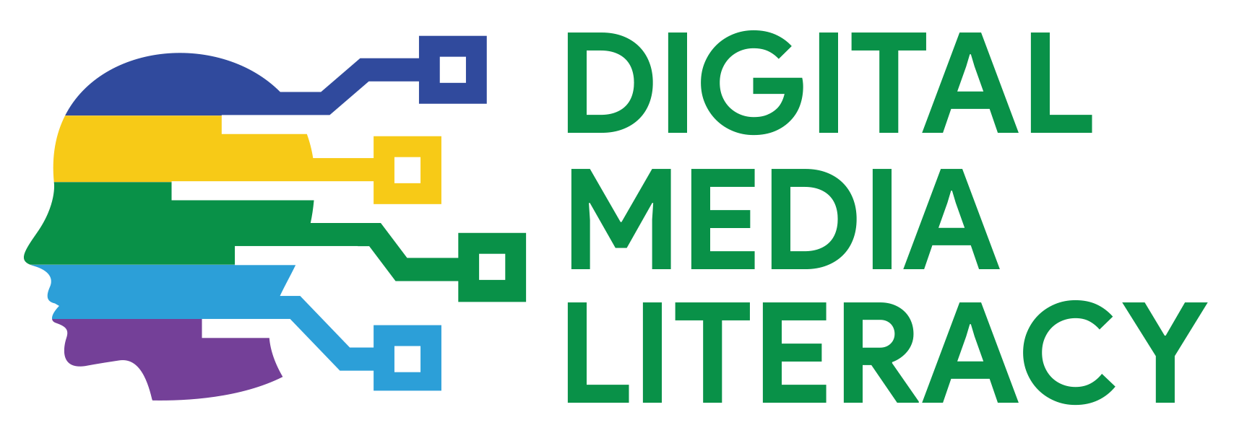
www.digitalyouth.eu
Creative Commons Attribution-NonCommercial 4.0 International License
Attribution-NonCommercial (CC BY-NC 4.0)
You will have to acknowledge the author (when mentioned) and to refer to YDML project.
You are free to:
Share — copy and redistribute the material in any medium or format for free use
Adapt — remix, transform, and build upon the material
The YDML project has been funded with support from the European Commission in the frames of Erasmus+ program, KA2 (ref. No 608788-EPP-1-2019-1-BG-EPPKA2-CBY-ACPALA). This publication reflects the views only of the author, and the Commission cannot be held responsible for any use which may be made of the information contained therein.

