Slide 1
Digitalna medijska pismenost
www.digitalyouth.eu

Slide 2
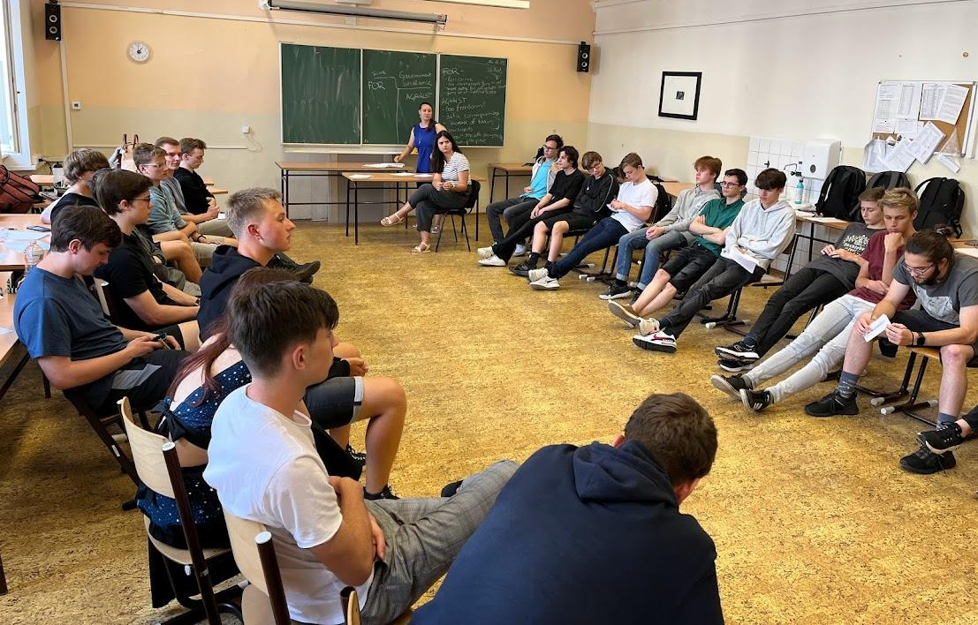
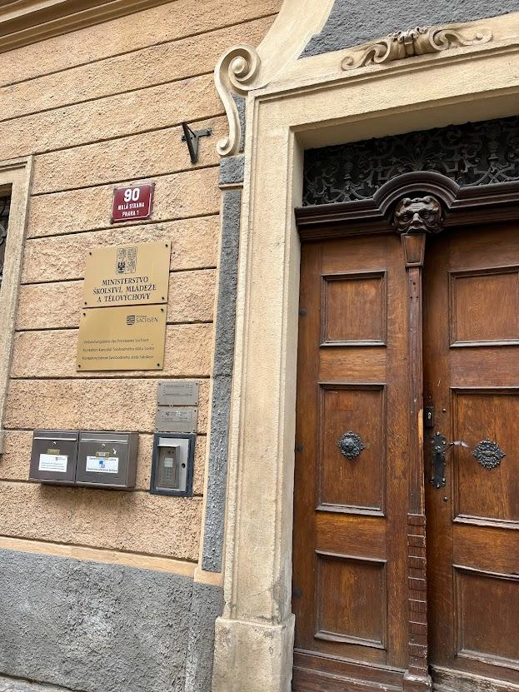
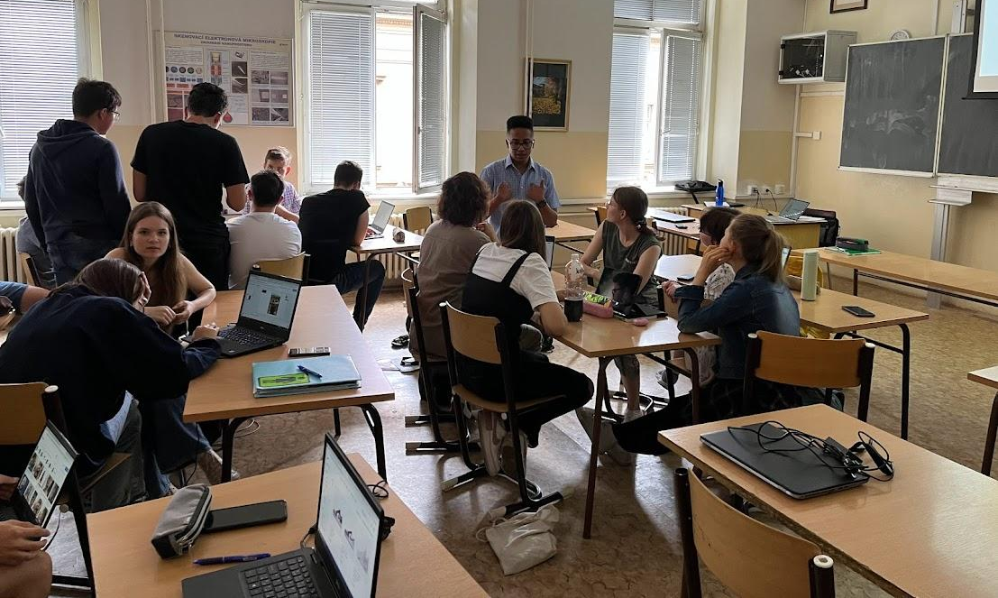
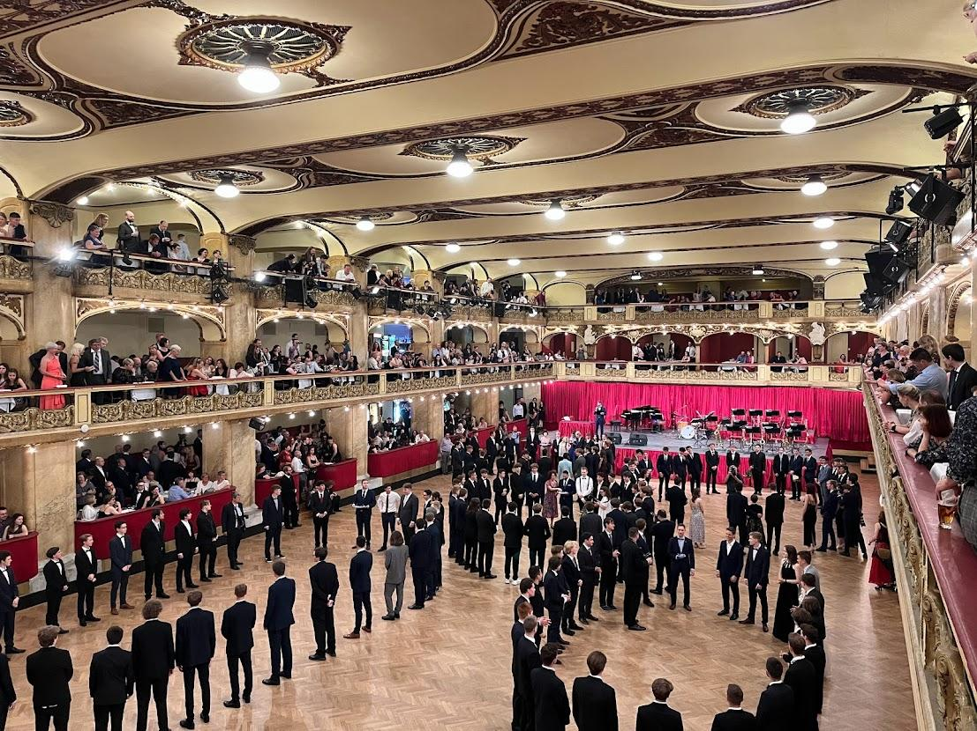
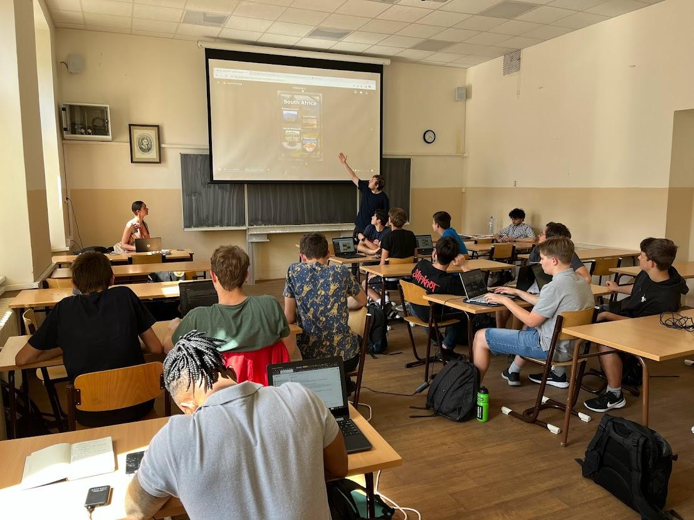
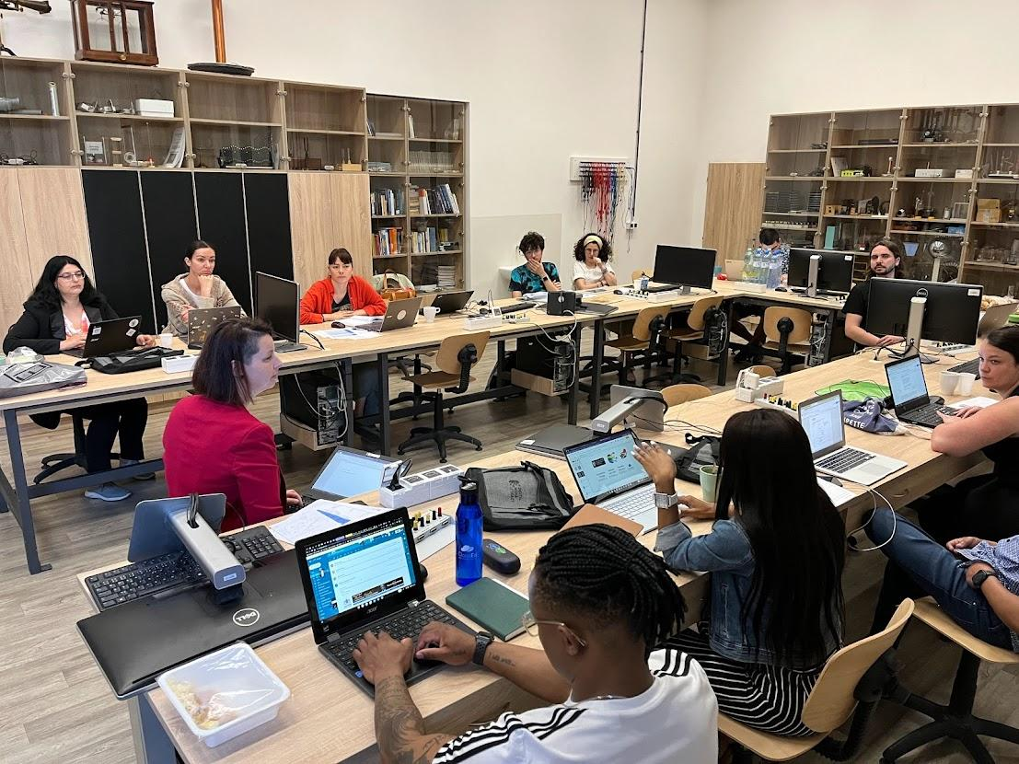

Slide 3
Aktivnosti za lomljenje ledu

Slide 4
Digitalna medijska pismenost - razprava

Slide 5
Digitalna pismenost
Digitalna medijska pismenost
Medijska pismenost

Slide 6
Pismenost ali kompetenca*?
Digitalna medijska pismenost
Digitalna pismenost
Medijska pismenost
*Competence = knowledge, skills, attitude

Slide 7
Digitalna medijska pismenost
Digitalna pismenost
Medijska pismenost

Slide 8
Medijska pismenost

Slide 9
Kaj je medijska pismenost? - Delite svoje mnenje!
Ni prave ali napačne definicije.
Svoje mnenje delite z drugimi udeleženci delavnice.
Tako bomo oblikovali skupno opredelitev medijske pismenosti za našo konkretno skupino.
Notes:
https://medialiteracynow.org/what-is-media-literacy/
Set of skills that helps people to analyze the messages that they receive and send; to unlock the meaning…
5 key questions: 1/ Who created that message; 2/ What creative techniques are used to attract my attention?; 3/ How might different people understand this message differently from me?; 4/ What lifestyles, values and points of view are represented in or omitted from this message?; 5/ Why is this message being sent?
Media literacy expands the concept of literacy, as today’s messages come in many forms and literacy can no longer refer simply to the ability to read and write. Media Literacy is the ability to:
Decode media messages (including the systems in which they exist).
Assess the influence of those messages on thoughts, feelings, and behaviors.
Create media thoughtfully and conscientiously.
Key 21st century skill which teaches students to apply critical thinking to media messages and to use media to create their own messages; critical to the health and well-being (offers a solution to public health issues, such as body image issues and substance use, exacerbated by toxic media messages); Empowers all people to engage in a global media environment… (civic engagement; better digital citizens as we consume media, produce and share own stories);
Used well, the media can entertain and inform children in positive ways. However, since most children aren’t taught to use media thoughtfully, many media messages contribute to public health issues such as obesity, bullying and aggression, low self-esteem, depression, negative body image, risky sexual behavior, and substance abuse, among other problems.
=============
https://www.verywellmind.com/what-is-media-literacy-5214468
Media literacy is the ability to apply critical thinking skills to the messages, signs, and symbols transmitted through mass media.
According to the Center for Media Literacy, media literacy "provides a framework to access, analyze, evaluate, create, and participate with messages in a variety of forms—from print to video to the internet. Media literacy builds an understanding of the role of media in society as well as essential skills of inquiry and self-expression necessary for citizens of a democracy."
Media literacy enables us to understand and evaluate all of the media messages we encounter on a daily basis, empowering us to make better choices about what we choose to read, watch, and listen to. It also helps us become smarter, more discerning members of society. Media scholar W. James Potter observes that all media messages include four dimensions:¹⁰
Cognitive: the information that is being conveyed
Emotional: the underlying feelings that are being expressed
Aesthetic: the overall precision and artistry of the message
Moral: the values being conveyed through the message
Media psychologist Karen Dill-Shackleford suggests that we can use these four dimensions as a jumping off point to improve our media literacy skills.

Slide 10
Medijska pismenost - različne definicije
1/ Medijska pismenost je sposobnost uporabe veščin kritičnega razmišljanja pri sporočilih, znakih in simbolih, ki jih posredujejo množični mediji.
2/ Medijska pismenost je sposobnost:
dekodirati medijska sporočila (vključno s sistemi, v katerih obstajajo);
oceniti vpliv teh sporočil na misli, čustva in vedenje;
premišljeno in vestno ustvarjati medije.
3/ Po podatkih Centra za medijsko pismenost medijska pismenost "zagotavlja okvir za dostop, analizo, vrednotenje, ustvarjanje in sodelovanje s sporočili v različnih oblikah - od tiska do videa in interneta. Medijska pismenost gradi razumevanje vloge medijev v družbi ter bistvene spretnosti raziskovanja in samoizražanja, ki so potrebne za državljane demokracije".
Strokovnjak za medije W. James Potter ugotavlja, da imajo vsa medijska sporočila štiri razsežnosti:
Kognitivno: informacije, ki se posredujejo.
Čustveno: izraženi občutki, ki se skrivajo v ozadju.
Estetsko: umetniškost sporočila
Moralno: vrednote, ki jih sporočilo izraža
Notes:
https://medialiteracynow.org/what-is-media-literacy/
Set of skills that helps people to analyze the messages that they receive and send; to unlock the meaning…
5 key questions: 1/ Who created that message; 2/ What creative techniques are used to attract my attention?; 3/ How might different people understand this message differently from me?; 4/ What lifestyles, values and points of view are represented in or omitted from this message?; 5/ Why is this message being sent?
Media literacy expands the concept of literacy, as today’s messages come in many forms and literacy can no longer refer simply to the ability to read and write. Media Literacy is the ability to:
Decode media messages (including the systems in which they exist) [>>>> напр. мемета?]
Assess the influence of those messages on thoughts, feelings, and behaviors.
Create media thoughtfully and conscientiously.
Key 21st century skill which teaches students to apply critical thinking to media messages and to use media to create their own messages; critical to the health and well-being (offers a solution to public health issues, such as body image issues and substance use, exacerbated by toxic media messages); Empowers all people to engage in a global media environment… (civic engagement; better digital citizens as we consume media, produce and share own stories);
Used well, the media can entertain and inform children in positive ways. However, since most children aren’t taught to use media thoughtfully, many media messages contribute to public health issues such as obesity, bullying and aggression, low self-esteem, depression, negative body image, risky sexual behavior, and substance abuse, among other problems.
=============
https://www.verywellmind.com/what-is-media-literacy-5214468
Media literacy is the ability to apply critical thinking skills to the messages, signs, and symbols transmitted through mass media.
According to the Center for Media Literacy, media literacy "provides a framework to access, analyze, evaluate, create, and participate with messages in a variety of forms—from print to video to the internet. Media literacy builds an understanding of the role of media in society as well as essential skills of inquiry and self-expression necessary for citizens of a democracy."
Media literacy enables us to understand and evaluate all of the media messages we encounter on a daily basis, empowering us to make better choices about what we choose to read, watch, and listen to. It also helps us become smarter, more discerning members of society. Media scholar W. James Potter observes that all media messages include four dimensions:¹⁰
Cognitive: the information that is being conveyed
Emotional: the underlying feelings that are being expressed
Aesthetic: the overall precision and artistry of the message
Moral: the values being conveyed through the message
Media psychologist Karen Dill-Shackleford suggests that we can use these four dimensions as a jumping off point to improve our media literacy skills.

Slide 11
Digitalna pismenost

Slide 12
Kaj je digitalna pismenost? - Delite svoje mnenje!
Ni prave ali napačne definicije.
Svoje mnenje delite z drugimi udeleženci delavnice.
Tako bomo oblikovali skupno opredelitev digitalne pismenosti za našo konkretno skupino.
Notes:
Key competences for LLL (2018): Digital competence involves the confident, critical and responsible use of, and engagement with, digital technologies for learning, at work, and for participation in society. It includes information and data literacy, communication and collaboration, media literacy, digital content creation (including programming), safety (including digital well-being and competences related to cybersecurity), intellectual property related questions, problem solving and critical thinking.

Slide 13
Digitalna pismenost
V skladu s priporočilom o ključnih kompetencah za vseživljenjsko učenje (2018):
Digitalna kompetenca vključuje samozavestno, kritično in odgovorno uporabo digitalnih tehnologij in sodelovanje z njimi pri učenju, delu in sodelovanju v družbi. Vključuje informacijsko in podatkovno pismenost, komunikacijo in sodelovanje, medijsko pismenost, ustvarjanje digitalnih vsebin (vključno s programiranjem), varnost (vključno z digitalnim blagostanjem in kompetencami, povezanimi s kibernetsko varnostjo), vprašanja, povezana z intelektualno lastnino, reševanje problemov in kritično mišljenje.
Znanje... osnovno delovanje in uporaba različnih naprav, programske opreme in omrežij; kritičen pristop do veljavnosti, zanesljivosti in vpliva informacij in podatkov...
Spretnosti ... sposobnost uporabe, dostopa, filtriranja, vrednotenja, ustvarjanja, programiranja in deljenja digitalnih vsebin; upravljanje in varovanje informacij, vsebin, podatkov in digitalnih identitet; prepoznavanje in učinkovito sodelovanje s programsko opremo, napravami, umetno inteligenco ali roboti
Odnosi ... kritičen, vendar radoveden, odprt ... etičen, varen in odgovoren pristop k uporabi
Notes:
Key competences for LLL (2018): Digital competence involves the confident, critical and responsible use of, and engagement with, digital technologies for learning, at work, and for participation in society. It includes information and data literacy, communication and collaboration, media literacy, digital content creation (including programming), safety (including digital well-being and competences related to cybersecurity), intellectual property related questions, problem solving and critical thinking.
The Official Journal 2018/C 189/01: https://eur-lex.europa.eu/legal-content/EN/TXT/?uri=OJ%3AC%3A2018 %3A189 %3ATOC

Slide 14
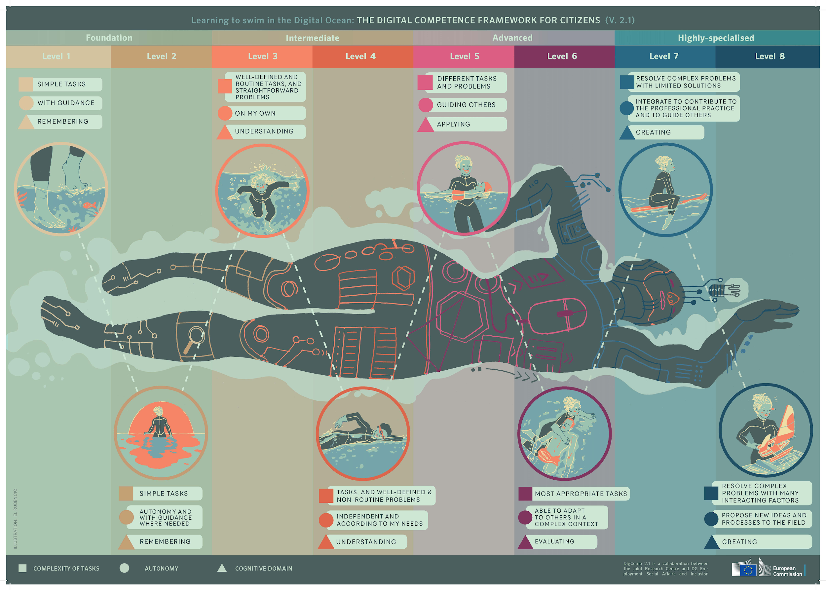
DigCom
Sposobnost plavanja v digitalnem oceanu.
Notes:
4 levels: Foundation; Intermediate; Advanced; Highly specialised – each level has 2 steps
The levels differ by: complexity of tasks (person can do); autonomy (with guidance, on his own… to guide others) & cognitive domain (remembering, understanding, applying, evaluating, creating)

Slide 15
Medijska pismenost in ključne kompetence
Pismenost:
Znanje: sposobnost prepoznavanja, razumevanja, izražanja, ustvarjanja in razlaganja pojmov, občutkov, dejstev in mnenj v ustni in pisni obliki z uporabo vizualnih, zvočnih/avdio in digitalnih gradiv na različnih področjih in v različnih kontekstih...
spretnosti: ustno in pisno sporazumevanje + iskanje, zbiranje in obdelava informacij, uporaba pripomočkov
Medijska pismenost se obravnava tudi kot del ključne kompetence državljanstvo - med spretnostmi za državljanstvo (sposobnost dostopa do tradicionalnih in novih oblik medijev, njihovega kritičnega razumevanja in interakcije z njimi ter razumevanje vloge in funkcij medijev v demokratičnih družbah).
Notes:
The 8 key competences for LLL: Literacy competence; Multilingual competence; Mathematical competence and competence in science, technology and engineering; Digital competence; Personal, social and learning to learn competence; Citizenship competence; Entrepreneurship competence; Cultural awareness and expression competence
The Official Journal 2018/C 189/01: https://eur-lex.europa.eu/legal-content/EN/TXT/?uri=OJ%3AC%3A2018 %3A189 %3ATOC

Slide 16
Povzetek
Medijska pismenost in digitalna pismenost:
Kako sta povezani?
Katera je glavna in katera je njen del?
Ali je prav vprašati, katera je glavna in katera podrejena?

Slide 17
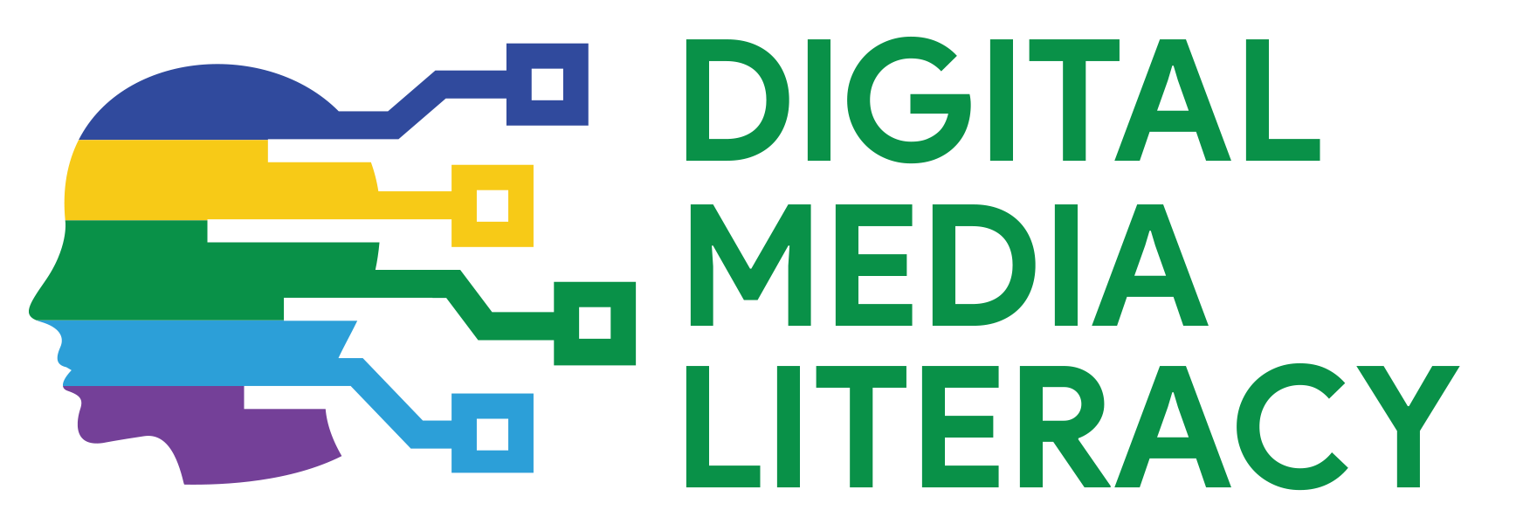
www.digitalyouth.eu
Creative Commons Attribution-NonCommercial 4.0 International License
Attribution-NonCommercial (CC BY-NC 4.0)
You will have to acknowledge the author (when mentioned) and to refer to YDML project.
You are free to:
Share — copy and redistribute the material in any medium or format for free use
Adapt — remix, transform, and build upon the material
The YDML project has been funded with support from the European Commission in the frames of Erasmus+ program, KA2 (ref. No 608788-EPP-1-2019-1-BG-EPPKA2-CBY-ACPALA). This publication reflects the views only of the author, and the Commission cannot be held responsible for any use which may be made of the information contained therein.

